Slide 2
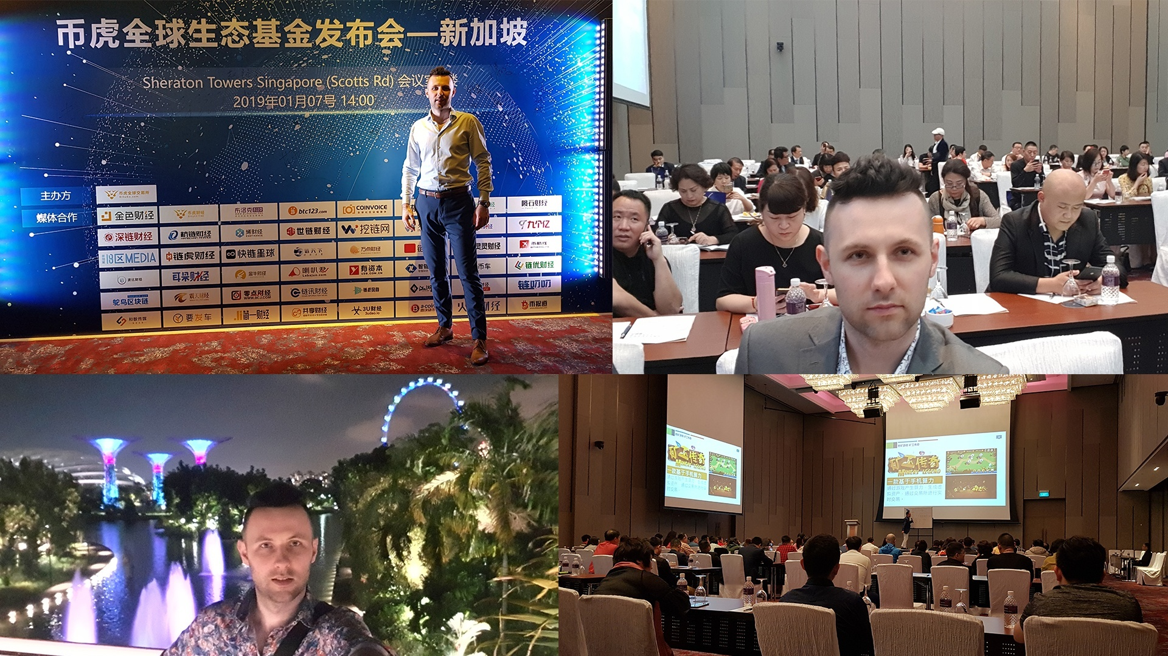

Slide 11
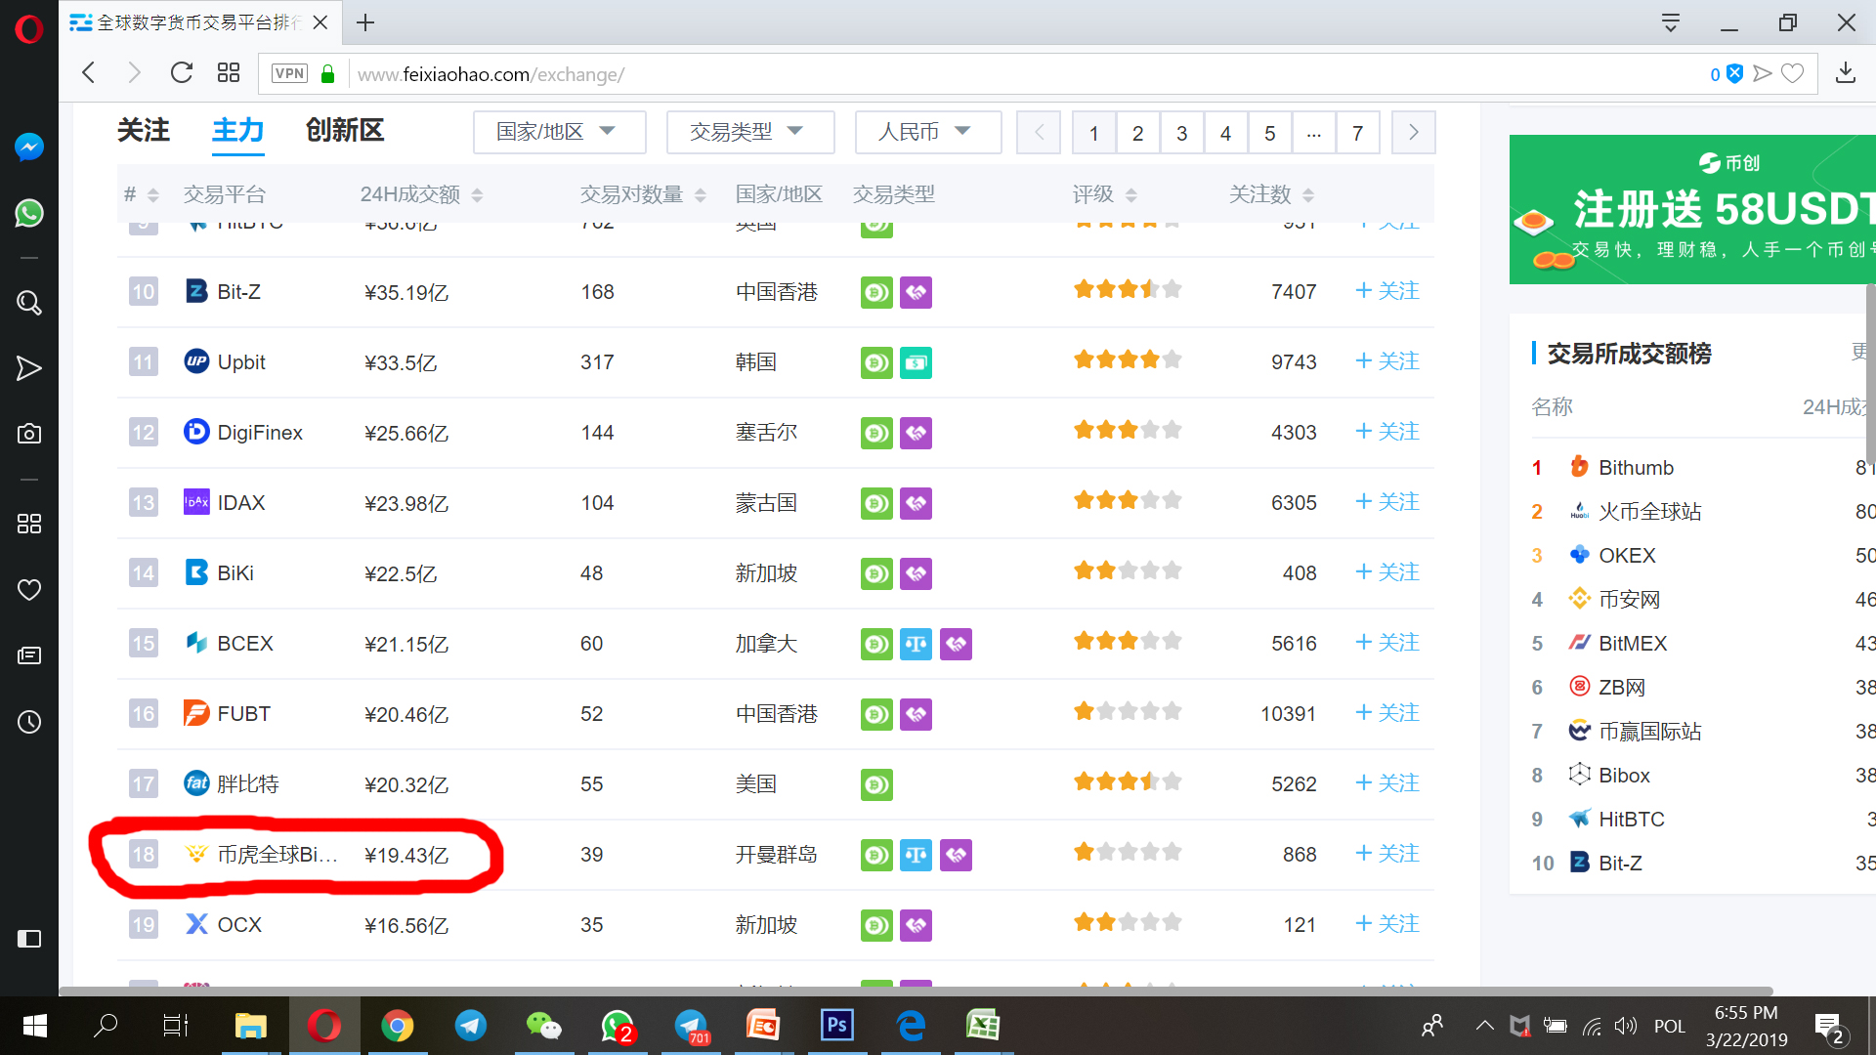

Slide 12
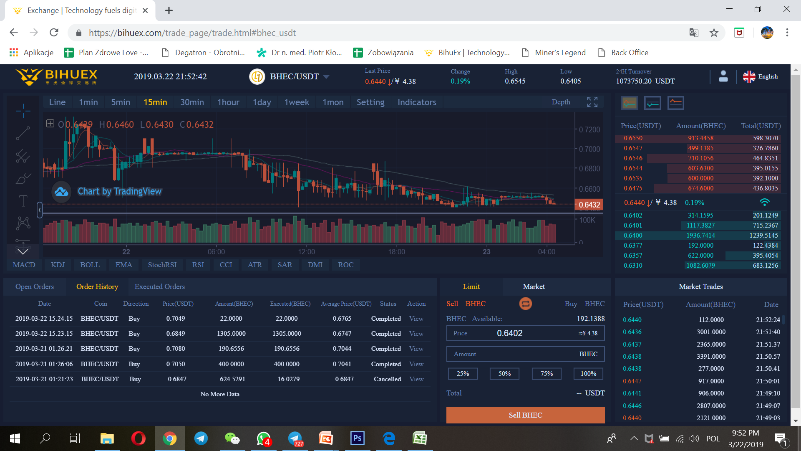

Slide 15
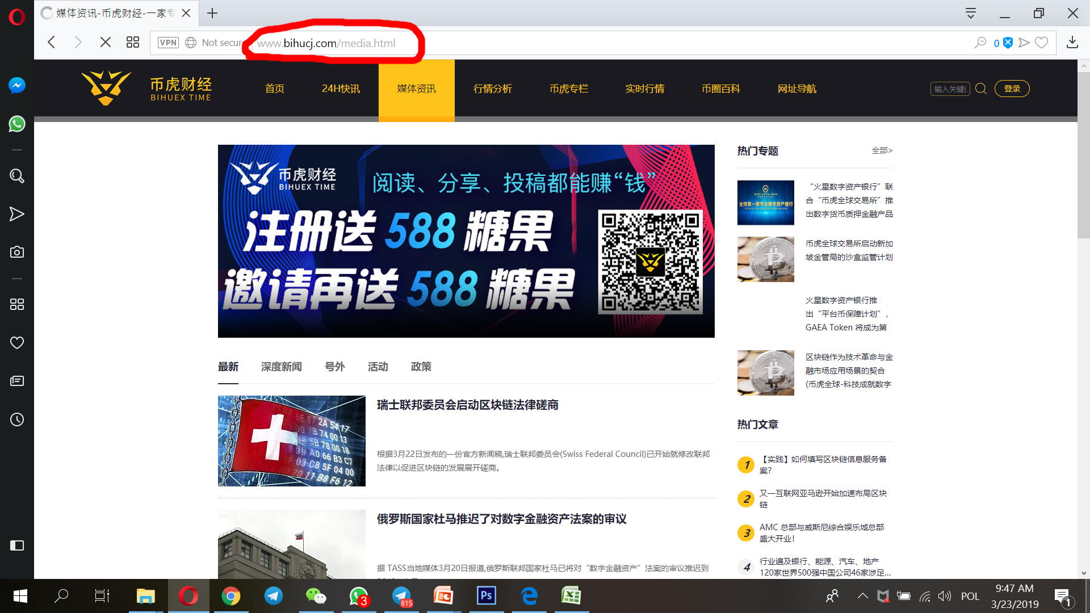

Slide 21
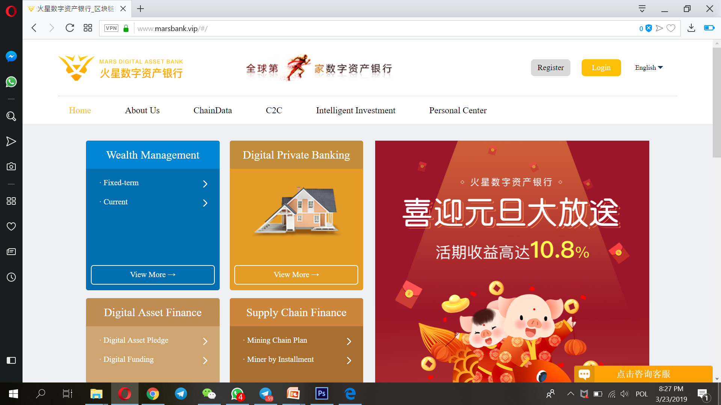

Slide 24
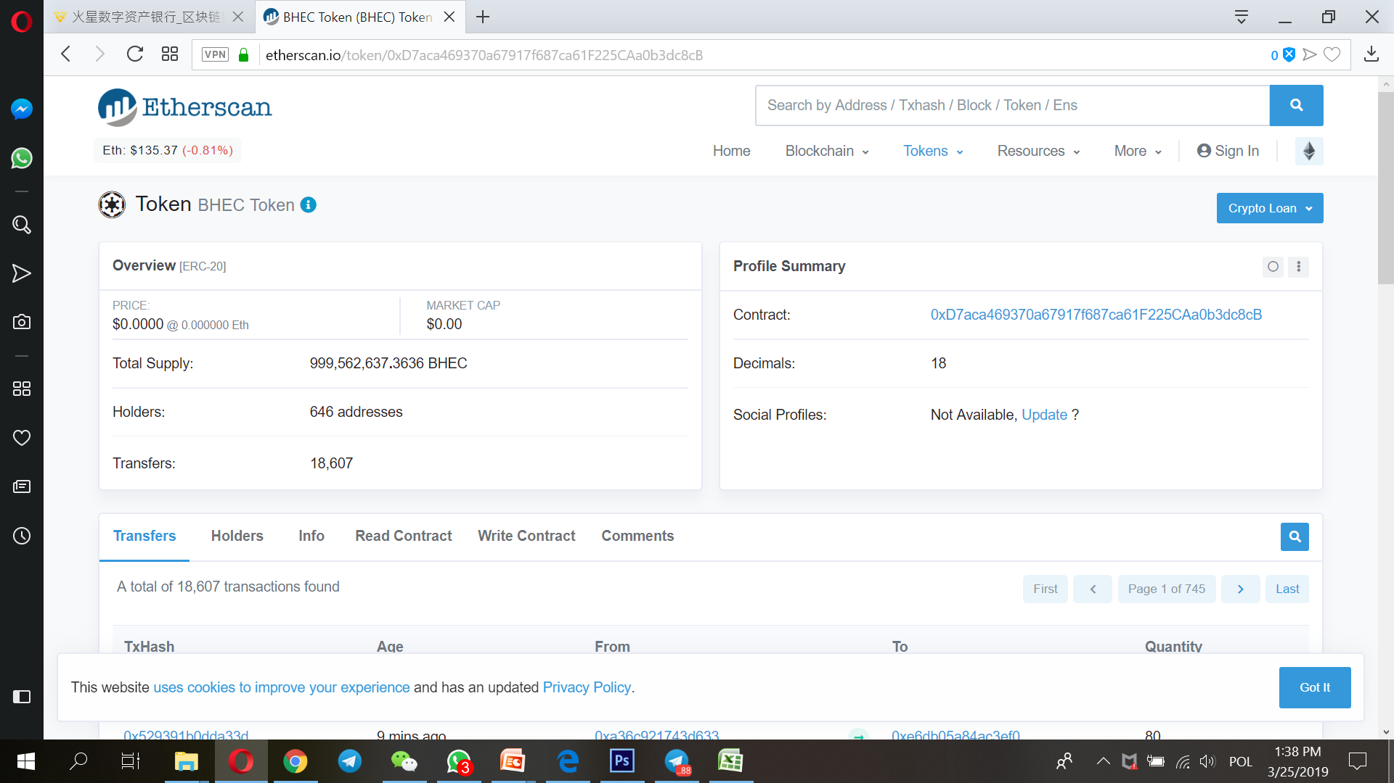

Slide 27
przez 365 dni
wypłaca BHEC w zależności od kursu
na giełdzie
5000 USD
sprzedaż BHEC osobom trzecim

Slide 28
Mining game - 1. Referral bonus
Low cost, easy to operate, powerful background support
1. Referral commission：8%
Recommend a member with 10,000
Obtain 500 x 8%
Everyone recommending new members is rewarded with USDT.
PS: If you start with USDT 500, and recommend a member with above USDT 2000, you can get 500*8%; if you start with USDT 2000, and recommend a member with above USDT 5000, you can get 2000*8%. If you want to upgrade, you need to start with a higher option, i.e., you can’t just purchase another USDT 1500 to upgrade from 500 to 2000.
10,000
Recommend a member with 5,000
Obtain 500 x 8%
5,000
Recommend a member with 2000
Obtain 500 x 8%
2,000
Start with 500
No upgrade
500

Slide 29
Mining game - 2. Tier bonus
You can get multipurpose Token to enjoy all services of Bihu Ecosystem.
Tier | 1 | 2 | 3 | 4 | 5 | 6 | 7 | 8
Percents | 10％ | 10％ | 10％ | 5％ | 5％ | 5％ | 2％ | 2％
A recommends 1 person and gets tier 1 bonus
A recommends 2 persons and gets tier 2 bonus
A recommends 3 persons and gets tier 3 bonus
A recommends 4 persons and gets tier 4 bonus
So on and so forth
Your income depends on persons recommended
PS: if you are at tier 1 and the member you recommended mines 4.1 token,
you get 0.41 token at the same day.

Slide 30
Mining game - 3. Level bonus
Low cost, easy to operate, powerful background support
Level III, overall performance, 4 million USDT
Community performance totaling 1 million, 1.5%
Level II, overall performance,1 million USDT
Community performance totaling 300,000, 1%
Level I, overall performance, 300,000 USDT
Community performance totaling 50,000, 0.5%
※ You won’t get the level bonus if a member has the same class.

